Slide 2
Problem 1
The head at the base of the nozzle of a Pelton wheel is 640 m. The outlet vane angle of the bucket is 15° . The relative velocity at the outlet is reduced by 15% due to friction along the vanes. If the discharge at outlet is without whirl find the ratio of bucket speed to the jet speed. If the jet diameter is 100 mm while the wheel diameter is 1.2 m, find the speed of the turbine in rpm, the force exerted by the jet on the wheel, the Power developed and the hydraulic efficiency. Take Cv=0.97.

Slide 3
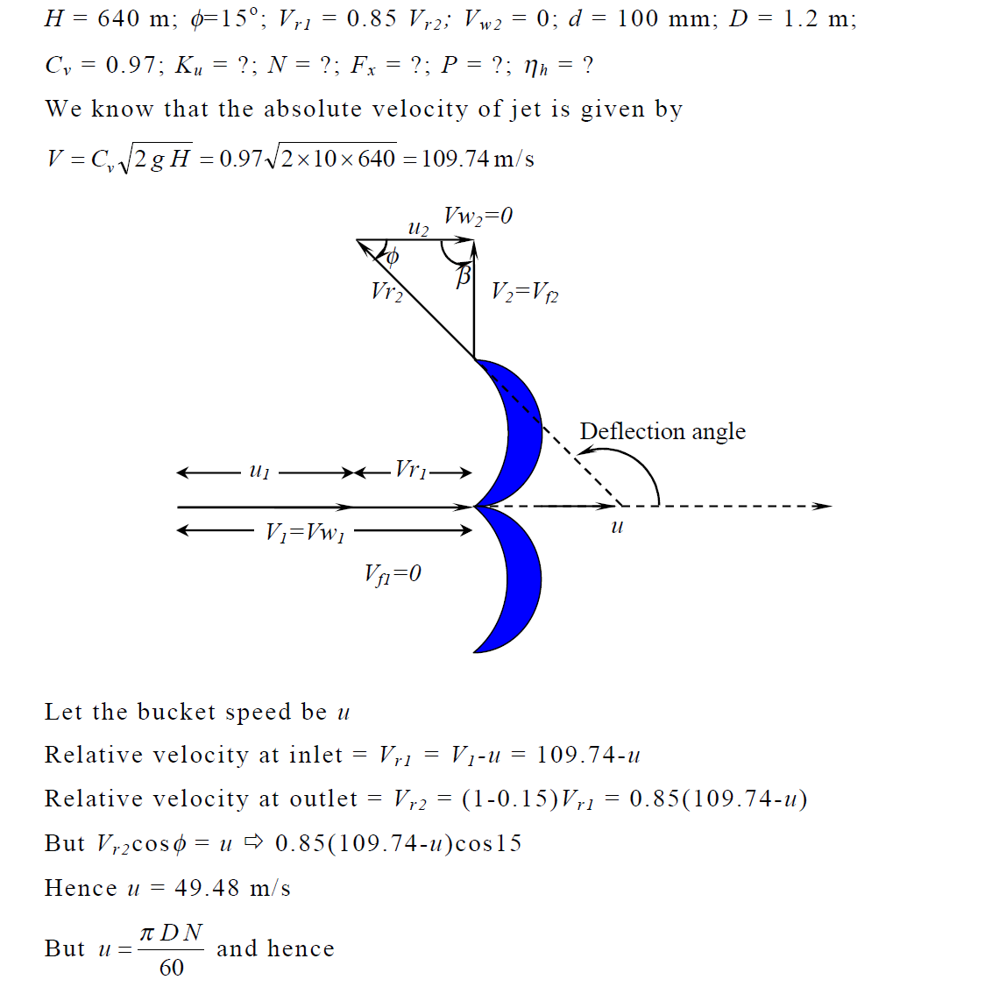

Slide 4
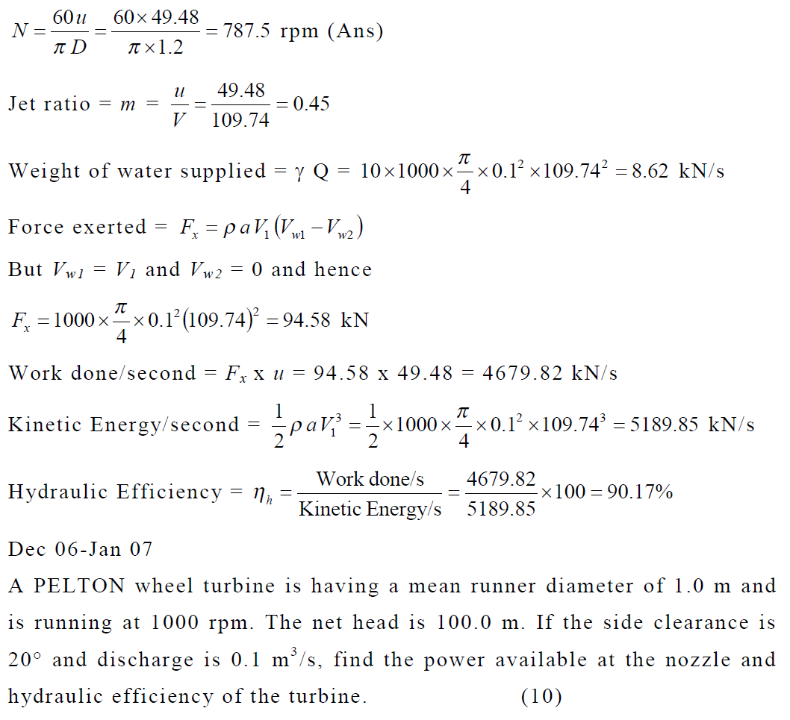

Slide 5
Problem 1
A PELTON wheel turbine is having a mean runner diameter of 1.0 m and is running at 1000 rpm. The net head is 100.0 m. If the side clearance is 20° and discharge is 0.1 m3 /s, find the power available at the nozzle and hydraulic efficiency of the turbine.

Slide 6
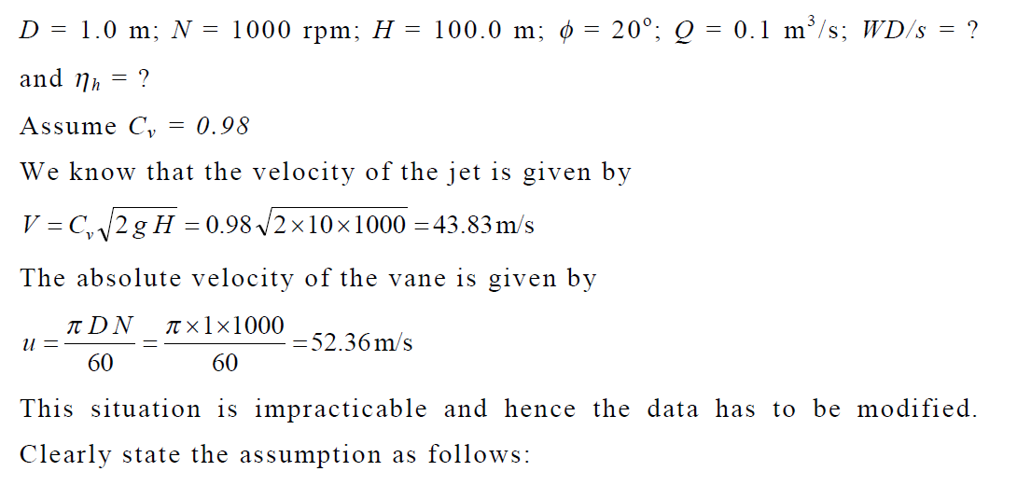

Slide 7
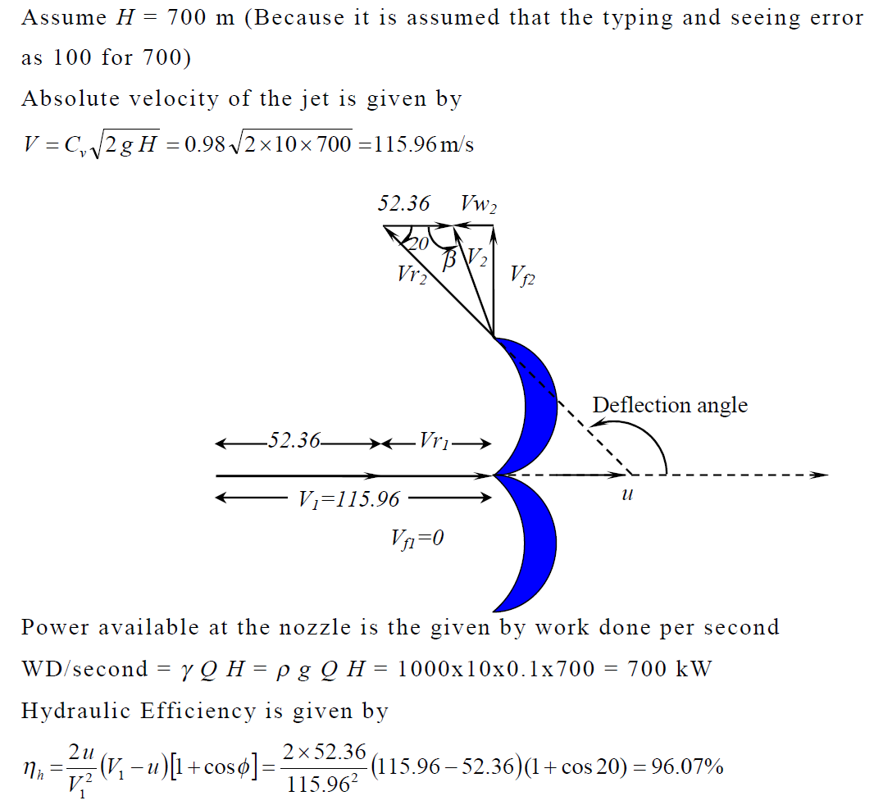

Slide 8
A double jet Pelton wheel develops 895 KW with an overall efficiency of 82% under a head of 60m. The speed ratio = 0.46, jet ratio = 12 and the nozzle coefficient = 0.97. Find the jet diameter, wheel diameter and wheel speed in RPM.

Slide 9
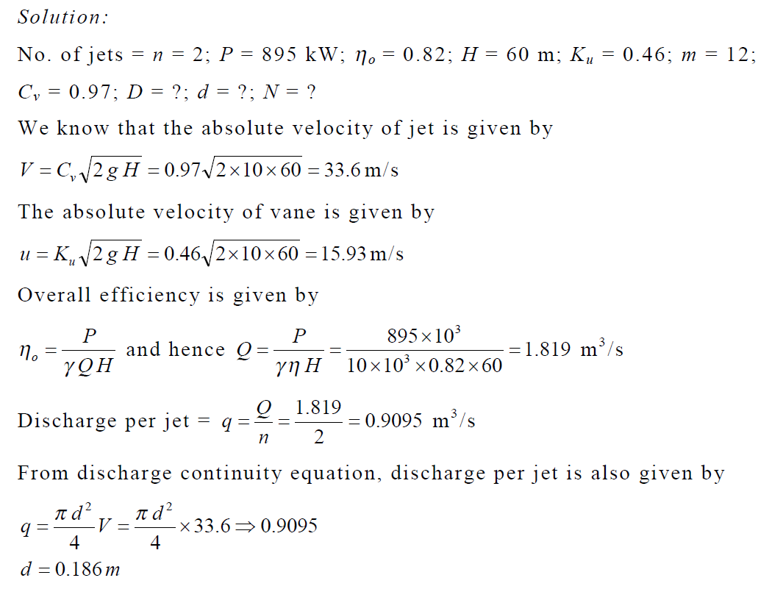

Slide 10
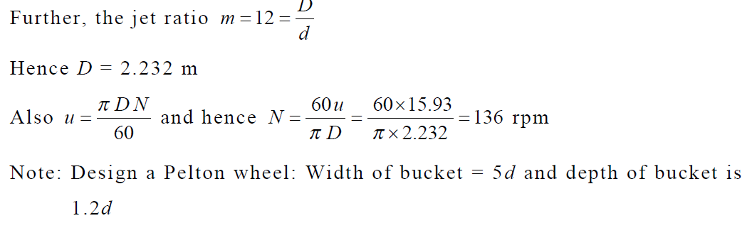

Slide 11
The following data is related to a Pelton wheel: Head at the base of the nozzle = 80m; Diameter of the jet = 100 mm; Discharge of the nozzle = 0.3m3 /s; Power at the shaft = 206 kW; Power absorbed in mechanical resistance = 4.5 kW. Determine
(i) Power lost in the nozzle and
(ii) Power lost due to hydraulic resistance in the runner.

Slide 12
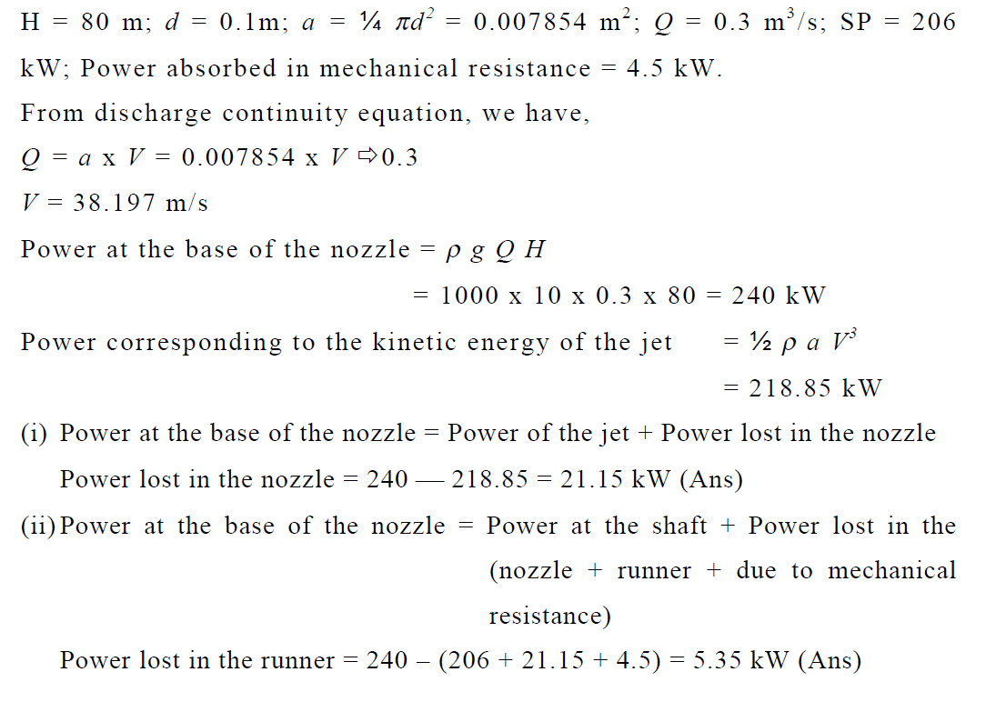

Slide 13
The water available for a Pelton wheel is 4 m3/s and the total head from reservoir to the nozzle is 250 m. The turbine has two runners with two jets per runner. All the four jets have the same diameters. The pipeline is 3000 m long. The efficiency if power transmission through the pipeline and the nozzle is 91% and efficiency of each runner is 90%. The velocity coefficient of each nozzle is 0.975 and coefficient of friction 4f for the pipe is 0.0045. Determine:
The power developed by the turbine;
The diameter of the jet and
The diameter of the pipeline.

Slide 14
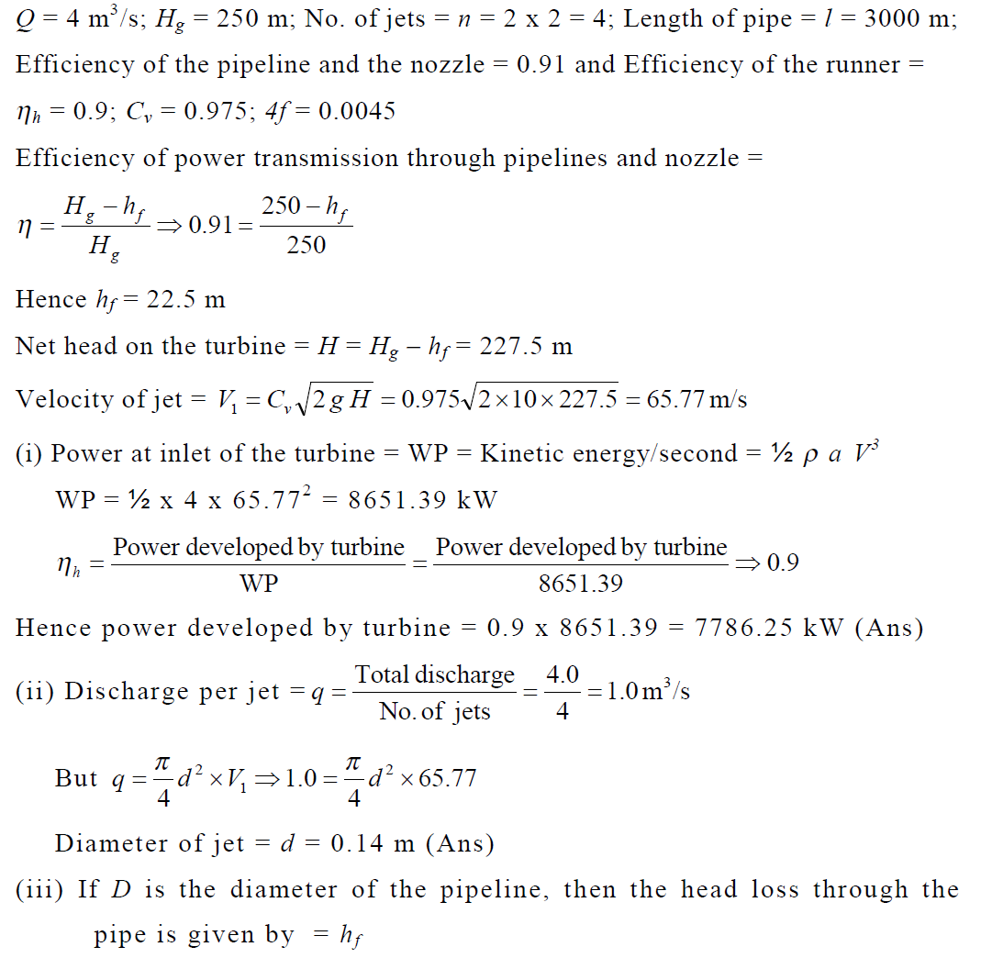

Slide 15
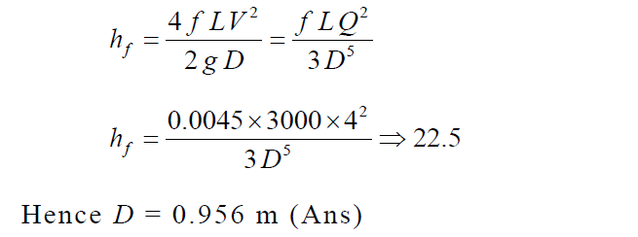

Slide 16
The water available for a Pelton wheel is 4 m3/s and the total head from reservoir to the nozzle is 250 m. The turbine has two runners with two jets per runner. All the four jets have the same diameters. The pipeline is 3000 m long. The efficiency if power transmission through the pipeline and the nozzle is 91% and efficiency of each runner is 90%. The velocity coefficient of each nozzle is 0.975 and coefficient of friction 4f for the pipe is 0.0045. Determine:
(i) The power developed by the turbine;
(ii) The diameter of the jet and
(iii) The diameter of the pipeline.

Slide 17
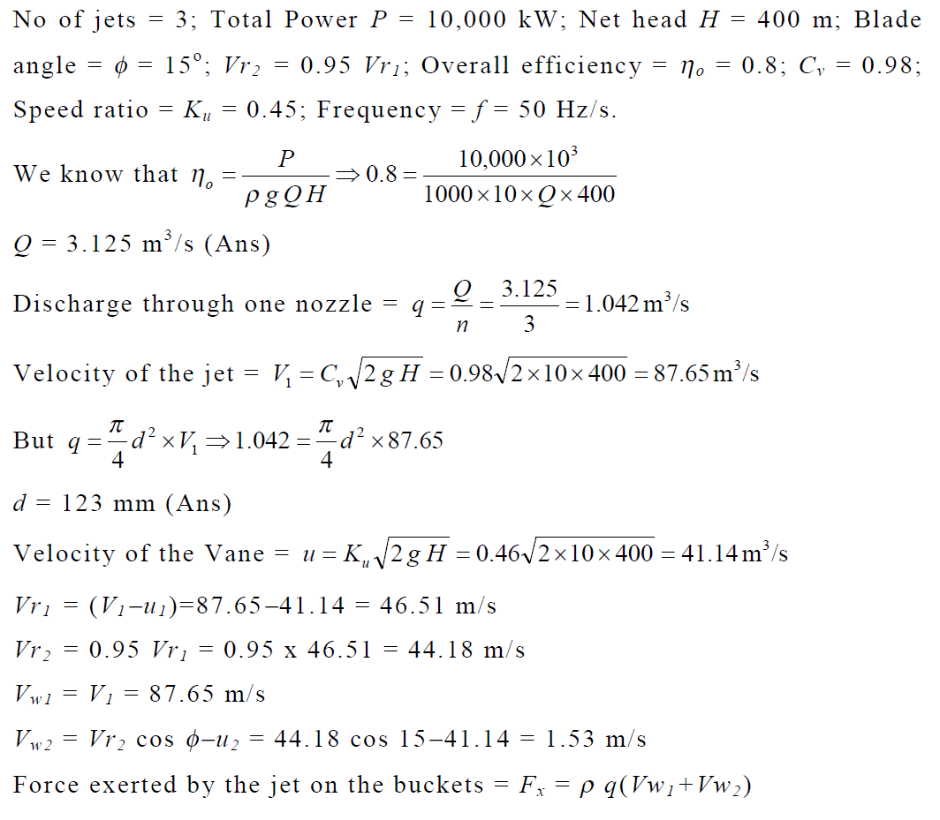

Slide 18
